Slide 1
Nearest Diet Challenge
By Vidya sagar Mallarapu,
Mail :mallarapuvidyasagar@gmail.com

Slide 2
Algorithm:
Step 1 :
Insertion of nodes into the binary search tree as family member name and diet number of diet biscuit as values .
Step 2:
Taking new input to find nearest diet of that family.
Resulting the nearest diet value.

Slide 3
Insertion of nodes :
struct btnode{
int val;
char person[1000];
struct btnode *l;
struct btnode *r;
}
It is the basic structure needed for us .Val is the diet value and person is the person name, *l is the left link and *r is the right link .

Slide 4
Main functions needed
Insertion ,printing diet of all family ,matching.

Slide 5
Absolute function :-
int abslt(int a,int b)
{
int c=a-b;
if(c<0)c*=-1;
return c;
}

Slide 6
Nearest function (½)
struct btnode* nearest(struct btnode *root1, int val){
if(root1->val == val)
return root1;
if(val < root1->val){
if(!root1->l)
return root1;
struct btnode * p = nearest(root1->l, val);
return abslt(p->val,val) > abslt(root1->val,val) ? root1 : p;
}

Slide 7
Nearest function (2/2)
else{
if(!root1->r)
return root1;
struct btnode * p = nearest(root1->r, val);
return abslt(p->val,val) > abslt(root1->val,val) ? root1 : p;
}
return NULL;
}
If the value in a node is same as the given value, it's the closest node;
If the value in a node is greater than the given value, move to the left child;
If the value in a node is less than the given value, move to the right child.

Slide 8
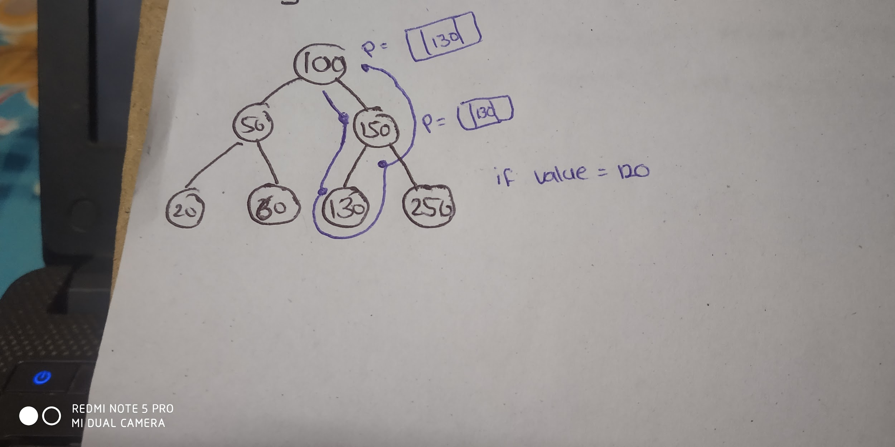
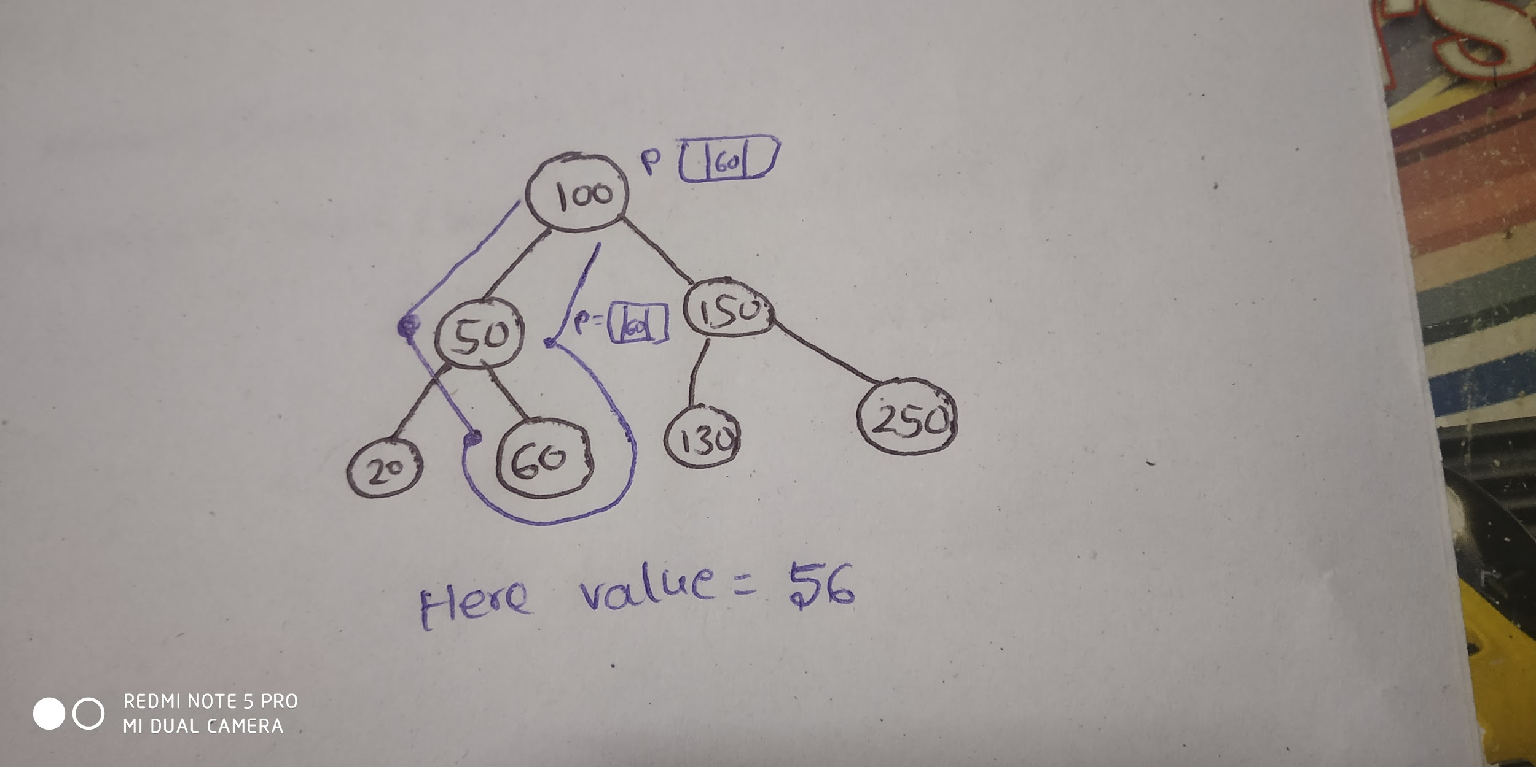
Description

Slide 9
description

